Slide 1



Arrays of Objects in C++
Object Oriented Programming
BSCYS-F24B
Presented By:
Haani Bin Qaiser
M. Rizwan
Made by Haani Bin Qaiser
Understanding Arrays of Objects
Array:
Array Of Objects:
An array where each element is an instance of a class.
Think of it as an array, but instead of numbers, it holds complex class instances.
Example:
Advantages:
An array of 'Car' objects, each representing a unique car with its own state.
Enables systematic iteration through elements, reduces code redundancy.

Slide 2


Understanding Arrays of Objects
Array:
Array Of Objects:
An array where each element is an instance of a class.
Think of it as an array, but instead of numbers, it holds complex class instances.
Arrays of Objects in C++
Declaring Arrays of Objects
Presented By:
Haani Bin Qaiser
M. Rizwan
Object Oriented Programming
BSCYS-F24B
Example:
Advantages:
1
Syntax
3
Note
2
Example
An array of 'Car' objects, each representing a unique car with its own state.
Enables systematic iteration through elements, reduces code redundancy.
The default constructor is automatically called for every object in the array.
ClassName objectArray[arraySize];
Car myCars[5];
Declares an array named myCars for 5 Car objects.
This is the basic structure.

Slide 3
Declaring Arrays of Objects
1
Syntax
2
Example
3
Note
The default constructor is automatically called for every object in the array.
ClassName objectArray[arraySize];
Car myCars[5];
Declares an array named myCars for 5 Car objects.
This is the basic structure.

Slide 4



Creating Arrays of Objects
Implicit Creation
If a default constructor exists, objects are created automatically. For example,
Car myCars[3];
calls
Car::Car()
three times.
Explicit Creation
For parameterized constructors, more advanced techniques are needed. This allows custom initialization for each object.
Initializing Arrays with Constructors
Loop and Assign
Iterate through the array, constructing and assigning each object individually.
for (int i=0; i<3; ++i) { myCars[i] Car(color[i], speed[i]); }
for (int i=0; i<3; ++i) { myCars[i] Car(color[i], speed[i]); }
Uniform Initialization(C++11)
A more concise way to initialize arrays with specific constructor calls.
Car myCars[] = { Car("Red", 60), Car("Blue", 70) };
Car myCars[] = { Car("Red", 60), Car("Blue", 70) };

Slide 5
Creating Arrays of Objects
Implicit Creation
If a default constructor exists, objects are created automatically. For example,
Car myCars[3];
calls
Car::Car()
three times.
Explicit Creation
For parameterized constructors, more advanced techniques are needed. This allows custom initialization for each object.
Initializing Arrays with Constructors
Accessing Object Members
Loop and Assign
Iterate through the array, constructing and assigning each object individually.
Syntax
Arrays use 0-based indexing, from
Example Variables
Example Functions
for (int i=0; i<3; ++i) { myCars[i].set_Car(color[i], speed[i]);
}
objectArray[index].memberFunction();
0 to (arraySize - 1)
Indexing
cout << myCars[1].color;
myCars[0].accelerate();
objectArray[index].memberVariable;
Accesses a property of the second object.
Uniform Initialization(C++11)
Invokes a method on the first object.
A more concise way to initialize arrays with specific constructor calls.
Car myCars[] = { Car("Red", 60), Car("Blue", 70) };

Slide 6



Example: Array of 'Rectangle' Objects
Initializing Arrays with Constructors
Iterate through the array, constructing and assigning each object individually.
Car myCars[] = { Car("Red", 60), Car("Blue", 70) };
A more concise way to initialize arrays with specific constructor calls.
for (int i=0; i<3; ++i) { myCars[i] Car(color[i], speed[i]); }
Uniform Initialization(C++11)
Loop and Assign
Array Initialization
Class Definition
Accessing Member
Class Definition
Rectangle rects[] = { Rectangle(2,3), Rectangle(4,5), Rectangle(6,7), Rectangle(8,9) };
cout << rects[2].area();
class Rectangle { float width; float height };
Initializes an array of Rectangle objects using parameterized constructors.
Accesses the area() method of the third Rectangle object, outputting 42.
Defines a simple Rectangle class with width, height, and area calculation.
Accessing Object Members
Syntax
Indexing
Arrays use 0-based indexing, from
objectArray[index].memberFunction();
0 to (arraySize - 1)
objectArray[index].memberVariable;
Example Functions
Example Variables
myCars[0].accelerate();
cout << myCars[1].color;
Invokes a method on the first object.
Accesses a property of the second object.

Slide 7

Properties of Arrays of Objects
Example: Array of 'Rectangle' Objects
Contiguous Memory
Class Definition
class Rectangle { float width; float height };
Objects within the array are stored in a single contiguous block of memory, improving cache performance.
Dynamic Storage
Defines a simple Rectangle class with width, height, and area calculation.
Array Initialization
Arrays of objects have dynamic storage capacities. The size can be determined at runtime, offering flexibility.
Rectangle rects[] = { Rectangle(2,3), Rectangle(4,5), Rectangle(6,7), Rectangle(8,9) };
Initializes an array of Rectangle objects using parameterized constructors.
Uniform Element Access
Accessing Member
Elements from the array can be treated uniformly using loops and algorithms, fostering efficient code design.
cout << rects[2].area();
Accesses the area() method of the third Rectangle object, outputting 42.

Slide 8
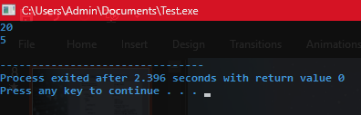


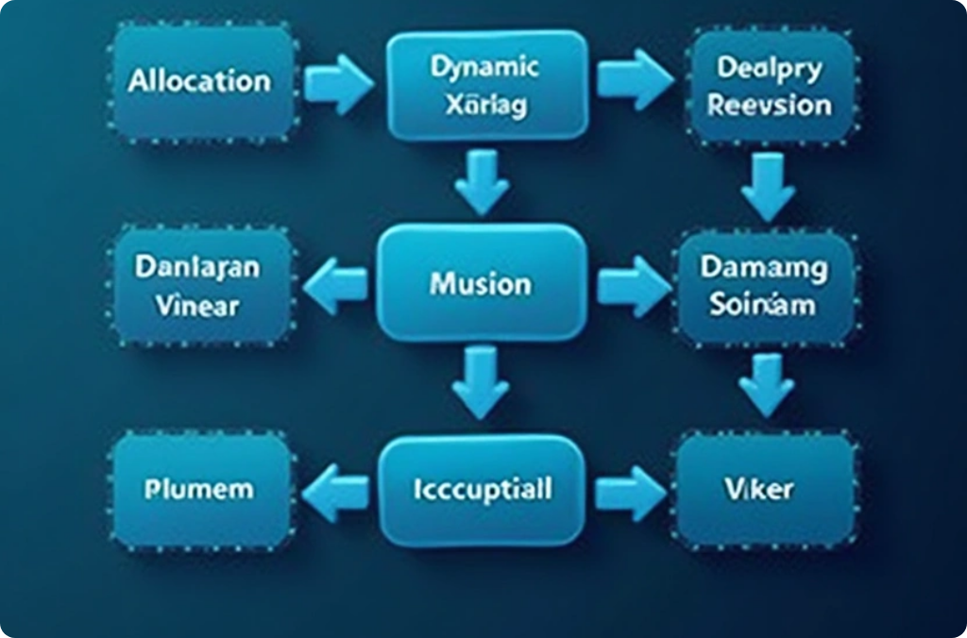
Properties of Arrays of Objects
Creating Arrays of Objects
#include <iostream>
using namespace std;
class test
{
private:
int testing;
public:
test()
{
testing = 0;
}
test(int t)
{
testing = t;
}
void set_Test(int t)
{
testing = t;
}
#include <iostream>
using namespace std;
class test
{
private:
int testing;
public:
test()
{
testing = 0;
}
test(int t)
{
testing = t;
}
void set_Test(int t)
{
testing = t;
}
int get_Test()
{
return testing;
}
};
int main()
{
test obj;
test objn(1);
test objt[5];
for(int i=0; i<5; i++)
objt[i].set_Test(i);
test arr[] = { test(10), test(20),
test(30), test(40), test(50) };
cout << arr[1].get_Test << endl;
arr[0].set_Test(5);
cout << arr[0].get_Test << endl;
return 0;
}
Int get_Test() { return testing; }
};
int main()
{
int t;
cout << “Enter the Number: “;
cin >> t;
test obj[5];
obj[0].set_Test(t);
obj[1].set_Test(2);
cout << “OBJ[0]: “ << obj[0].get_Test << endl;
cout << “OBJ[1]: “ << obj[1].get_Test << endl;
return 0;
}
Contiguous Memory
Objects within the array are stored in a single contiguous block of memory, improving cache performance.
Dynamic Storage
Arrays of objects have dynamic storage capacities. The size can be determined at runtime, offering flexibility.
Uniform Element Access
Elements from the array can be treated uniformly using loops and algorithms, fostering efficient code design.
Array Initialization
Accessing Member
Complex Objects
Static Arrays
Dynamic Arrays
Class Definition
Rectangle rects[] = { Rectangle(2,3), Rectangle(4,5), Rectangle(6,7), Rectangle(8,9) };
cout << rects[2].area();
class Rectangle { float width; float height };
Require custom constructors and destructors.
Memory is managed automatically.
Use new and delete[] properly.
Initializes an array of Rectangle objects using parameterized constructors.
Accesses the area() method of the third Rectangle object, outputting 42.
Defines a simple Rectangle class with width, height, and area calculation.

Slide 9
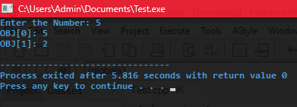
Properties of Arrays of Objects
Creating Arrays of Objects
#include <iostream>
using namespace std;
class test
{
private:
int testing;
public:
test()
{
testing = 0;
}
test(int t)
{
testing = t;
}
void set_Test(int t)
{
testing = t;
}
Int get_Test() { return testing; }
};
int main()
{
int t;
cout << “Enter the Number: “;
cin >> t;
test obj[5];
obj[0].set_Test(t);
obj[1].set_Test(2);
cout << “OBJ[0]: “ << obj[0].get_Test << endl;
cout << “OBJ[1]: “ << obj[1].get_Test << endl;
return 0;
}
Contiguous Memory
Objects within the array are stored in a single contiguous block of memory, improving cache performance.
Dynamic Storage
Arrays of objects have dynamic storage capacities. The size can be determined at runtime, offering flexibility.
Uniform Element Access
Elements from the array can be treated uniformly using loops and algorithms, fostering efficient code design.
Class Definition
class Rectangle { float width; float height };
Defines a simple Rectangle class with width, height, and area calculation.
Array Initialization
Complex Objects
Static Arrays
Dynamic Arrays
Rectangle rects[] = { Rectangle(2,3), Rectangle(4,5), Rectangle(6,7), Rectangle(8,9) };
Require custom constructors and destructors.
Memory is managed automatically.
Use new and delete[] properly.
Initializes an array of Rectangle objects using parameterized constructors.
Accessing Member
cout << rects[2].area();
Accesses the area() method of the third Rectangle object, outputting 42.

Slide 10
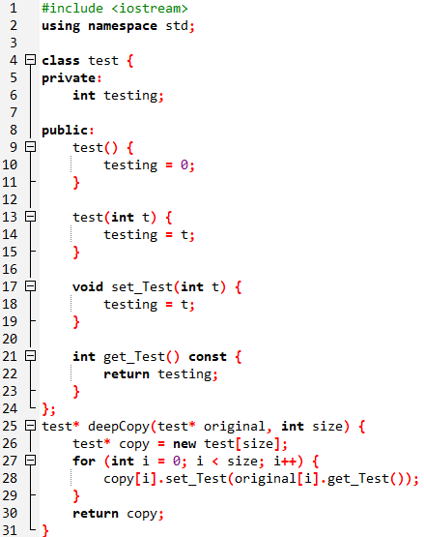
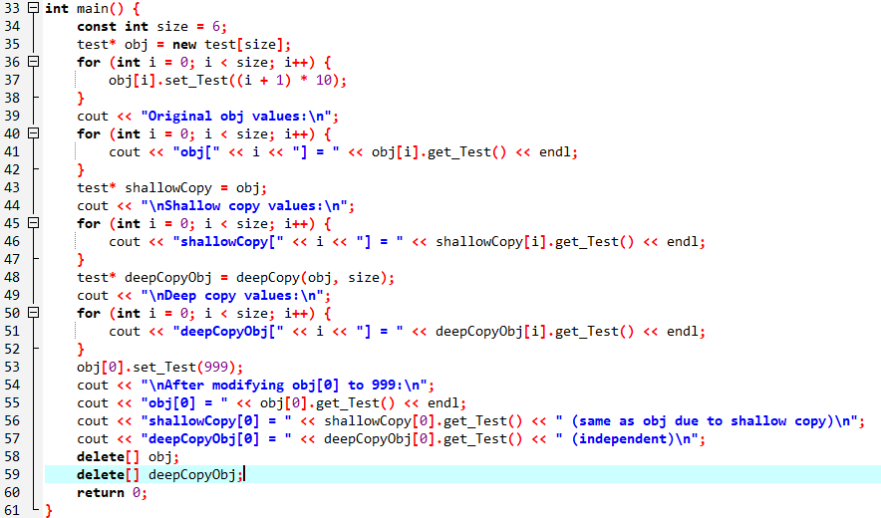
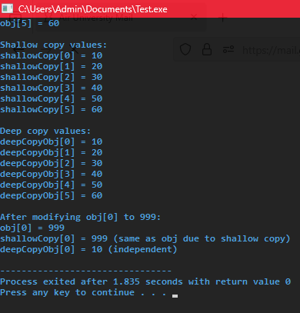
Properties of Arrays of Objects
Creating Arrays of Objects
#include <iostream>
using namespace std;
class test
{
private:
int testing;
public:
test()
{
testing = 0;
}
test(int t)
{
testing = t;
}
void set_Test(int t)
{
testing = t;
}
#include <iostream>
using namespace std;
class test
{
private:
int testing;
public:
test()
{
testing = 0;
}
test(int t)
{
testing = t;
}
void set_Test(int t)
{
testing = t;
}
Int get_Test() { return testing; }
};
int main()
{
int t;
cout << “Enter the Number: “;
cin >> t;
test obj[5];
obj[0].set_Test(t);
obj[1].set_Test(2);
cout << “OBJ[0]: “ << obj[0].get_Test << endl;
cout << “OBJ[1]: “ << obj[1].get_Test << endl;
return 0;
}
int get_Test()
{
return testing;
}
};
int main()
{
test obj;
test objn(1);
test objt[5];
for(int i=0, i<5; i++)
objt[i] = i+1;
test arr[] = { test(10), test(20),
test(30), test(40), test(50) };
cout << arr[1].get_Test << endl;
arr[0].set_Test(5);
cout << arr[0].get_Test << endl;
return 0;
}
Contiguous Memory
Objects within the array are stored in a single contiguous block of memory, improving cache performance.
Dynamic Storage
Arrays of objects have dynamic storage capacities. The size can be determined at runtime, offering flexibility.
Uniform Element Access
Elements from the array can be treated uniformly using loops and algorithms, fostering efficient code design.
Class Definition
class Rectangle { float width; float height };
Defines a simple Rectangle class with width, height, and area calculation.
Array Initialization
Complex Objects
Static Arrays
Dynamic Arrays
Rectangle rects[] = { Rectangle(2,3), Rectangle(4,5), Rectangle(6,7), Rectangle(8,9) };
Require custom constructors and destructors.
Memory is managed automatically.
Use new and delete[] properly.
Initializes an array of Rectangle objects using parameterized constructors.
Accessing Member
cout << rects[2].area();
Accesses the area() method of the third Rectangle object, outputting 42.

Slide 11
Properties of Arrays of Objects
Creating Arrays of Objects
#include <iostream>
using namespace std;
class test
{
private:
int testing;
public:
test()
{
testing = 0;
}
test(int t)
{
testing = t;
}
void set_Test(int t)
{
testing = t;
}
#include <iostream>
using namespace std;
class test
{
private:
int testing;
public:
test()
{
testing = 0;
}
test(int t)
{
testing = t;
}
void set_Test(int t)
{
testing = t;
}
Int get_Test() { return testing; }
};
int main()
{
int t;
cout << “Enter the Number: “;
cin >> t;
test obj[5];
obj[0].set_Test(t);
obj[1].set_Test(2);
cout << “OBJ[0]: “ << obj[0].get_Test << endl;
cout << “OBJ[1]: “ << obj[1].get_Test << endl;
return 0;
}
int get_Test()
{
return testing;
}
};
int main()
{
test obj;
test objn(1);
test objt[5];
for(int i=0, i<5; i++)
objt[i] = i+1;
test arr[] = { test(10), test(20),
test(30), test(40), test(50) };
cout << arr[1].get_Test << endl;
arr[0].set_Test(5);
cout << arr[0].get_Test << endl;
return 0;
}
Contiguous Memory
Objects within the array are stored in a single contiguous block of memory, improving cache performance.
Dynamic Storage
Arrays of objects have dynamic storage capacities. The size can be determined at runtime, offering flexibility.
Uniform Element Access
Elements from the array can be treated uniformly using loops and algorithms, fostering efficient code design.
Class Definition
class Rectangle { float width; float height };
Defines a simple Rectangle class with width, height, and area calculation.
Array Initialization
Complex Objects
Static Arrays
Dynamic Arrays
Rectangle rects[] = { Rectangle(2,3), Rectangle(4,5), Rectangle(6,7), Rectangle(8,9) };
Require custom constructors and destructors.
Memory is managed automatically.
Use new and delete[] properly.
Initializes an array of Rectangle objects using parameterized constructors.
Accessing Member
cout << rects[2].area();
Accesses the area() method of the third Rectangle object, outputting 42.

Slide 12
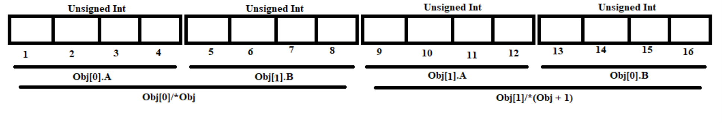
Properties of Arrays of Objects
Arrays of Objects in Memory
#include <iostream>
using namespace std;
class test
{
private:
int testing;
public:
test()
{
testing = 0;
}
test(int t)
{
testing = t;
}
void set_Test(int t)
{
testing = t;
}
#include <iostream>
using namespace std;
class test
{
private:
int testing;
public:
test()
{
testing = 0;
}
test(int t)
{
testing = t;
}
void set_Test(int t)
{
testing = t;
}
Int get_Test() { return testing; }
};
int main()
{
int t;
cout << “Enter the Number: “;
cin >> t;
test obj[5];
obj[0].set_Test(t);
obj[1].set_Test(2);
cout << “OBJ[0]: “ << obj[0].get_Test << endl;
cout << “OBJ[1]: “ << obj[1].get_Test << endl;
return 0;
}
int get_Test()
{
return testing;
}
};
int main()
{
test obj;
test objn(1);
test objt[5];
for(int i=0, i<5; i++)
objt[i] = i+1;
test arr[] = { test(10), test(20),
test(30), test(40), test(50) };
cout << arr[1].get_Test << endl;
arr[0].set_Test(5);
cout << arr[0].get_Test << endl;
return 0;
}
Contiguous Memory
Objects within the array are stored in a single contiguous block of memory, improving cache performance.
Dynamic Storage
class Test
{
public:
unsigned int A;
unsigned int B;
};
int main()
{
Test Obj[2];
return 0;
}
Note: Arrays of objects can be accessed using two
Notations:
Obj[i];
*Obj; for the first array object
*(Obj + i) for further objects
Examples:
Test arr[5];
(*(arr + 1)).set_height();
Test* arr = new Test[5];
Test second = *(arr + 1);
Arrays of objects have dynamic storage capacities. The size can be determined at runtime, offering flexibility.
Uniform Element Access
Elements from the array can be treated uniformly using loops and algorithms, fostering efficient code design.
Class Definition
class Rectangle { float width; float height };
Defines a simple Rectangle class with width, height, and area calculation.
Array Initialization
Complex Objects
Static Arrays
Dynamic Arrays
Rectangle rects[] = { Rectangle(2,3), Rectangle(4,5), Rectangle(6,7), Rectangle(8,9) };
Require custom constructors and destructors.
Memory is managed automatically.
Use new and delete[] properly.
Initializes an array of Rectangle objects using parameterized constructors.
Accessing Member
cout << rects[2].area();
Accesses the area() method of the third Rectangle object, outputting 42.

Slide 13
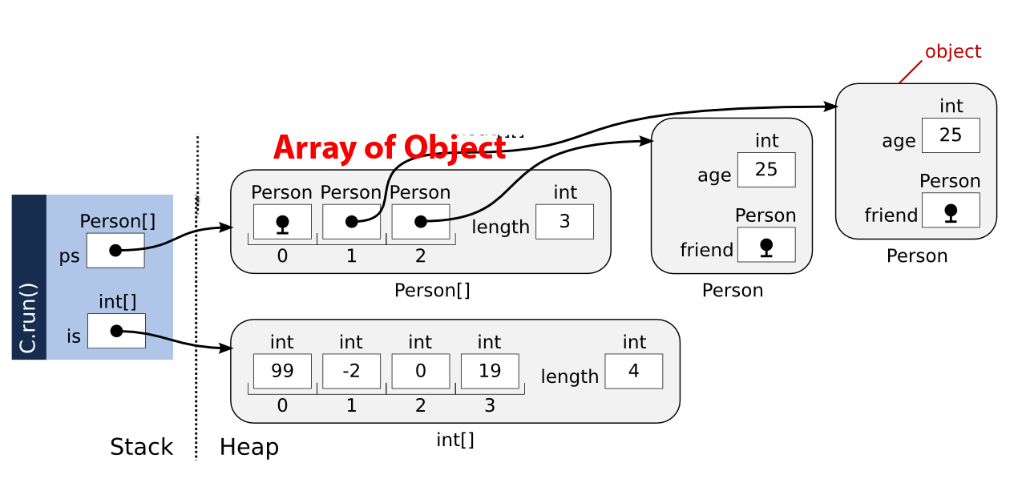
Properties of Arrays of Objects
Dynamic Object Arrays in Memory
#include <iostream>
using namespace std;
class test
{
private:
int testing;
public:
test()
{
testing = 0;
}
test(int t)
{
testing = t;
}
void set_Test(int t)
{
testing = t;
}
#include <iostream>
using namespace std;
class test
{
private:
int testing;
public:
test()
{
testing = 0;
}
test(int t)
{
testing = t;
}
void set_Test(int t)
{
testing = t;
}
Int get_Test() { return testing; }
};
int main()
{
int t;
cout << “Enter the Number: “;
cin >> t;
test obj[5];
obj[0].set_Test(t);
obj[1].set_Test(2);
cout << “OBJ[0]: “ << obj[0].get_Test << endl;
cout << “OBJ[1]: “ << obj[1].get_Test << endl;
return 0;
}
int get_Test()
{
return testing;
}
};
int main()
{
test obj;
test objn(1);
test objt[5];
for(int i=0, i<5; i++)
objt[i] = i+1;
test arr[] = { test(10), test(20),
test(30), test(40), test(50) };
cout << arr[1].get_Test << endl;
arr[0].set_Test(5);
cout << arr[0].get_Test << endl;
return 0;
}
Contiguous Memory
Objects within the array are stored in a single contiguous block of memory, improving cache performance.
Dynamic Storage
Arrays of objects have dynamic storage capacities. The size can be determined at runtime, offering flexibility.
Uniform Element Access
Elements from the array can be treated uniformly using loops and algorithms, fostering efficient code design.
Class Definition
class Rectangle { float width; float height };
Defines a simple Rectangle class with width, height, and area calculation.
Array Initialization
Complex Objects
Static Arrays
Dynamic Arrays
Rectangle rects[] = { Rectangle(2,3), Rectangle(4,5), Rectangle(6,7), Rectangle(8,9) };
Require custom constructors and destructors.
Memory is managed automatically.
Use new and delete[] properly.
Initializes an array of Rectangle objects using parameterized constructors.
Accessing Member
cout << rects[2].area();
Accesses the area() method of the third Rectangle object, outputting 42.

Slide 14



Properties of Arrays of Objects
Contiguous Memory
Objects within the array are stored in a single contiguous block of memory, improving cache performance.
2
Dynamic Storage
Arrays of objects have dynamic storage capacities. The size can be determined at runtime, offering flexibility.
1
Uniform Element Access
3
Elements from the array can be treated uniformly using loops and algorithms, fostering efficient code design.
Class Definition
class Rectangle { float width; float height };
Defines a simple Rectangle class with width, height, and area calculation.
Array Initialization
Complex Objects
Static Arrays
Dynamic Arrays
Rectangle rects[] = { Rectangle(2,3), Rectangle(4,5), Rectangle(6,7), Rectangle(8,9) };
Require custom constructors and destructors.
Memory is managed automatically.
Use new and delete[] properly.
Initializes an array of Rectangle objects using parameterized constructors.
Accessing Member
cout << rects[2].area();
Accesses the area() method of the third Rectangle object, outputting 42.

Slide 15
2
1
3
Memory Management
Efficient memory management is essential when using arrays of objects in C++. Dynamic arrays require careful handling to avoid memory leaks, while static arrays automatically manage memory. However, complex objects might still necessitate customized constructors and destructors for proper resource release.
Dynamic Arrays
Static Arrays
Complex Objects
Use new and delete[] properly.
Memory is managed automatically.
Require custom constructors and destructors.

Slide 16










Use Cases of Arrays of Objects
Practical Applications
Arrays of objects are powerful tools for organizing and managing complex data structures. They facilitate the efficient handling of large volumes of data through clear and structured formats, enabling enhanced performance and data integrity across various applications.
Game Development
Manage collections of enemies, items, or player characters efficiently.
Simulations
2
Creating environments where multiple entities interact.
Data Processing
Store and manipulate datasets as arrays of record objects.
Data Management
1
Managing collections such as employees, products, or students.
Performance Enhancement
Simulation
Model complex systems with multiple interacting components.
Ensuring data integrity and improving application performance.
3

Slide 17
Practical Applications
Game Development
Manage collections of enemies, items, or player characters efficiently.
Data Processing
Store and manipulate datasets as arrays of record objects.
Simulation
Model complex systems with multiple interacting components.

Slide 18
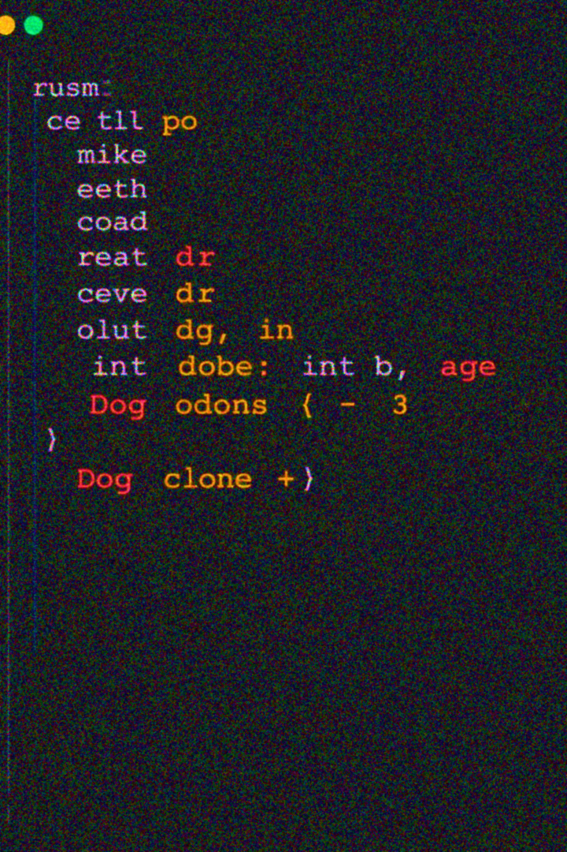



Conclusion on Arrays of Objects in C++
Efficient Storage
Arrays of objects are perfect for managing multiple class instances.
Crucial Details
Proper initialization and correct member access are vital for success.
Powerful Tool
Powerful Feature
Ease of Use
Developer Empowerment
Mastering this concept unlocks capabilities for complex C++ applications.
Arrays of objects in C++ enable efficient management of multiple class instances.
Their usability and bulk operation capabilities make them essential in programming.
Mastering array creation, access, and management enhances coding skills and optimizes solutions.
Next Steps
Explore dynamic arrays like std::vector for flexible sizing.

Slide 19

Summary and Key Takeaways
Efficient Storage
Arrays of objects are perfect for managing multiple class instances.
Crucial Details
Proper initialization and correct member access are vital for success.
Powerful Tool
Mastering this concept unlocks capabilities for complex C++ applications.
Next Steps
Explore dynamic arrays like std::vector for flexible sizing.
Developer Empowerment
Powerful Feature
Ease of Use
Mastering array creation, access, and management enhances coding skills and optimizes solutions.
Arrays of objects in C++ enable efficient management of multiple class instances.
Their usability and bulk operation capabilities make them essential in programming.

Slide 20
Summary and Key Takeaways
Thank You for Your Attention
Efficient Storage
Arrays of objects are perfect for managing multiple class instances.
Audience Appreciation
Encouragement to Experiment
Crucial Details
Thank you for your active participation!
Proper initialization and correct member access are vital for success.
Explore arrays of objects in C++ for your projects.
Powerful Tool
Mastering this concept unlocks capabilities for complex C++ applications.
Further Discussions
Any Queries
Feel free to reach out for any clarifications. Clearing Confusions helps to understand the topics better.
If You have any queries, please let me know. Questioning widens our field of knowledge and allows us to obtain answers to many quests
Next Steps
Explore dynamic arrays like std::vector for flexible sizing.

